Slide 1
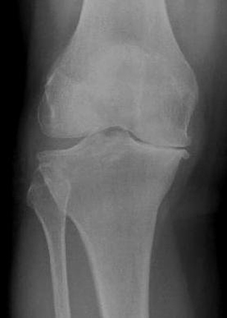
The Joint Commission
Validating the ALG-P Algorithm to Reduce Unexplained Pain Disparities in Underserved Populations

Slide 2
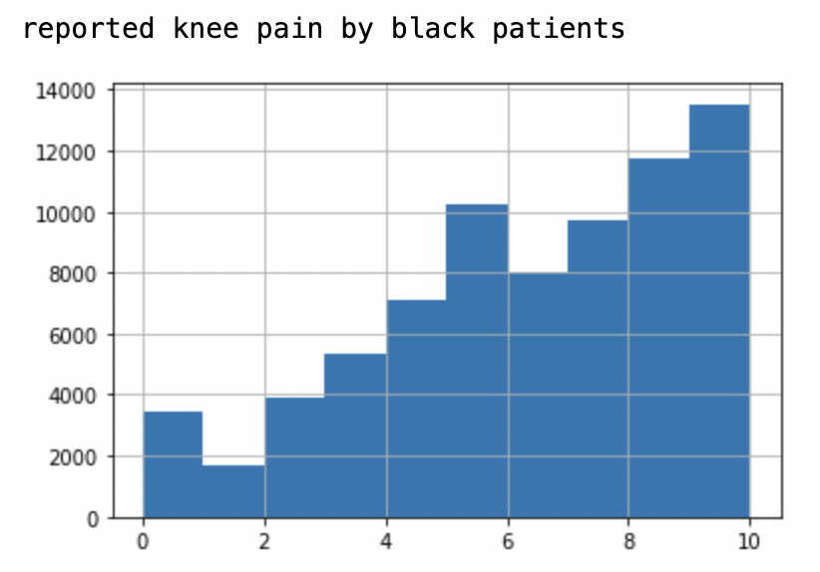
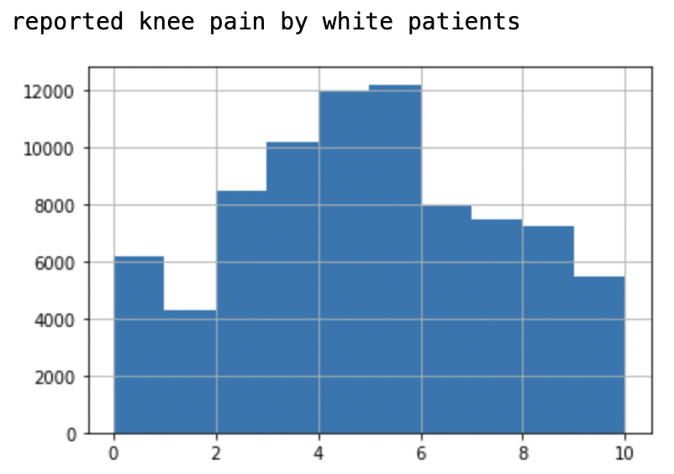
Background and Clinical Relevance Knee Pain Disparity

Slide 3
Background and Clinical Relevance
Pain scores in OA: People of Color >> White
Even after adjusting for disease severity
Theories
Intrinsic knee pathology
Extrinsic stressors
Measuring severity of OA
Anatomic change does not always correlate with subjective pain
KLG severity scale: non-representative: based on 85 subjects, age 55-64, ~90% white population
KLG scores account for only 9% of the racial difference in pain level

Slide 4
Background and Clinical Relevance
Pierson et al developed “ALG-P” AI algorithm for pain prediction from knee radiographs
Disparities in racial pain scores are better explained by the ALG-P (43%) app compared to KLG (9%)
Significance
Assess model generalizability on a new Emory dataset
Clinically relevant to therapeutic decision making (knee replacement) and potentially narrow the racial and socioeconomic disparities in pain
Capacity building at the datathon

Slide 5
Significance
Significance
Assess app generalizability
Understanding impact of race and racial bias on pain and clinical management
Capacity building at datathon
OA treatment depends on cause and severity
Injections/surgery/PT
Psychosocial interventions

Slide 6
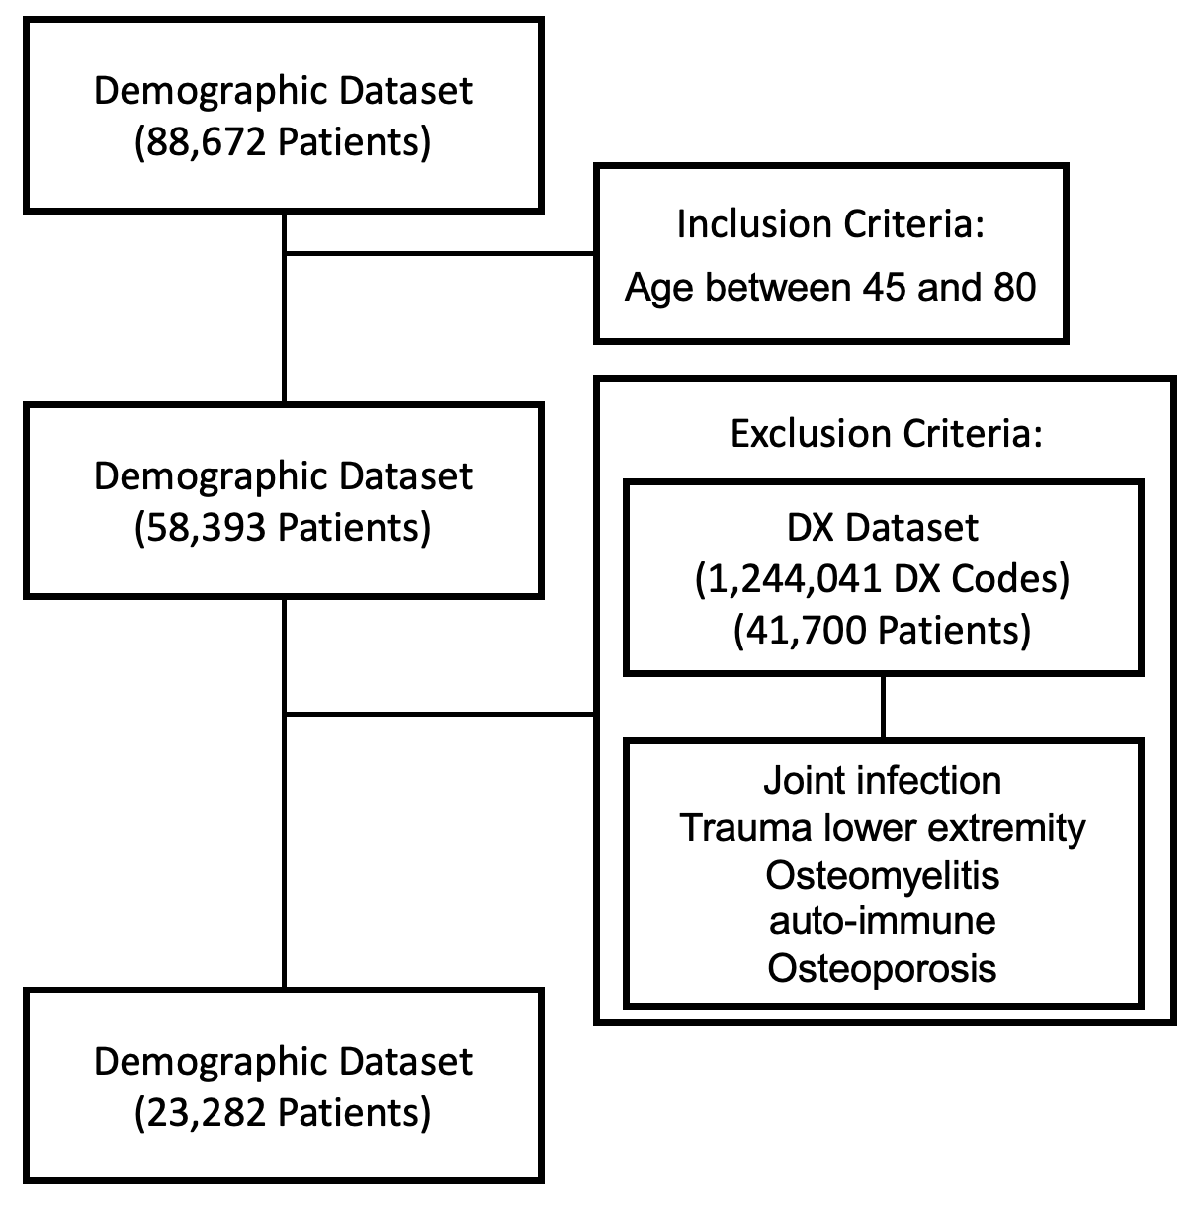

Slide 7
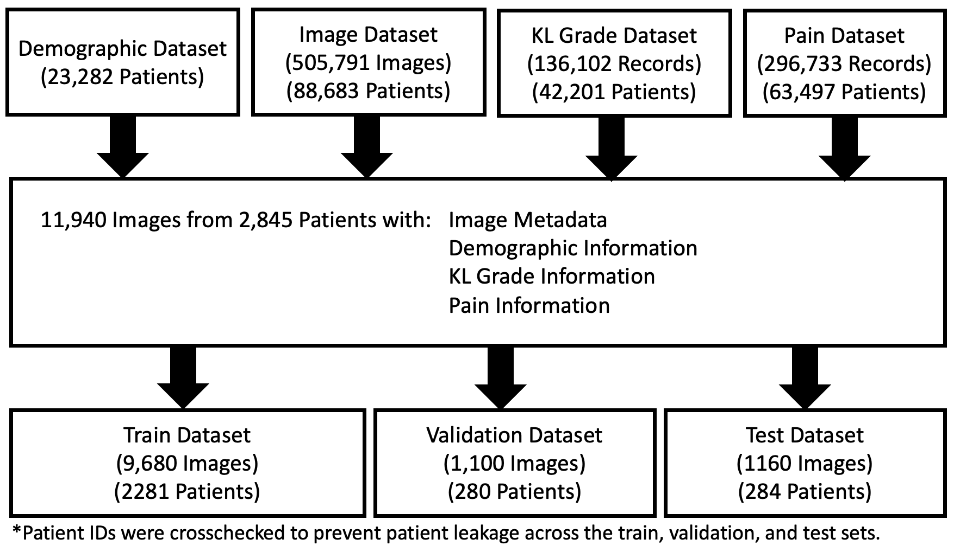

Slide 8
Our Predicted Value
We made binary labels based on the pain score (0 - 10)
First we used a threshold of >=4
We also tried a threshold of >=7

Slide 9
Cohort
Grouped by Knee Pain Binary Threshold 4
 |  | Overall | 0 | 1
AGE (median) |  | 67 | 68 | 66
GENDER, n (%) | Female | 8436 (70.6) | 2655 (65.6) | 5781 (73.2)
 | Male | 3512 (29.4) | 1391 (34.4) | 2121 (26.8)
RACE, n (%) | African American or Black | 5622 (47.1) | 1527 (37.7) | 4095 (51.8)
 | American Indian or Alaskan Native | 14 (0.1) | 3 (0.1) | 11 (0.1)
 | Asian | 500 (4.2) | 151 (3.7) | 349 (4.4)
 | Caucasian or White | 5180 (43.4) | 2161 (53.4) | 3019 (38.2)
 | Multiple | 86 (0.7) | 35 (0.9) | 51 (0.6)
 | Native Hawaiian or Other Pacific Islander | 26 (0.2) | 13 (0.3) | 13 (0.2)
 | Unknown, Unavailable or Unreported | 520 (4.4) | 156 (3.9) | 364 (4.6)
ETHNICITY, n (%) | Hispanic or Latino | 428 (3.6) | 125 (3.1) | 303 (3.8)
 | Non-Hispanic or Latino | 10488 (87.8) | 3582 (88.5) | 6906 (87.4)
 | Not Recorded | 54 (0.5) | 20 (0.5) | 34 (0.4)
 | Unreported, Unknown, Unavailable | 976 (8.2) | 318 (7.9) | 658 (8.3)
TOTAL (n) |  | 11948 | 4046 | 7902

Slide 10
Approach
Train a vision model to predict pain scores
Use a regression model using KLG arthritis severity scores to predict pain scores
Non-painful knee
Convolutional Neural Net
Painful
knee

Slide 11
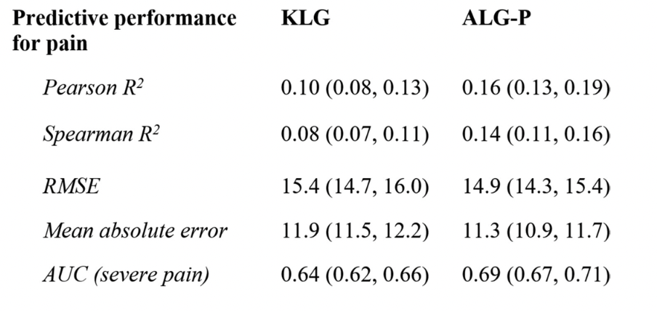
Results of prior study on a different knee dataset

Slide 12
Results
Using threshold of >= 4 Neural Net performance: 0.6637 AUC
Neural net performance without excluding ICD-10 codes: 0.6591 AUC
Using threshold of >= 7 Neural Net performance: 0.6711 AUC
Using 11 classes (0 to 10 pain score) -
Neural Net performance: 0.5277 AUC

Slide 13
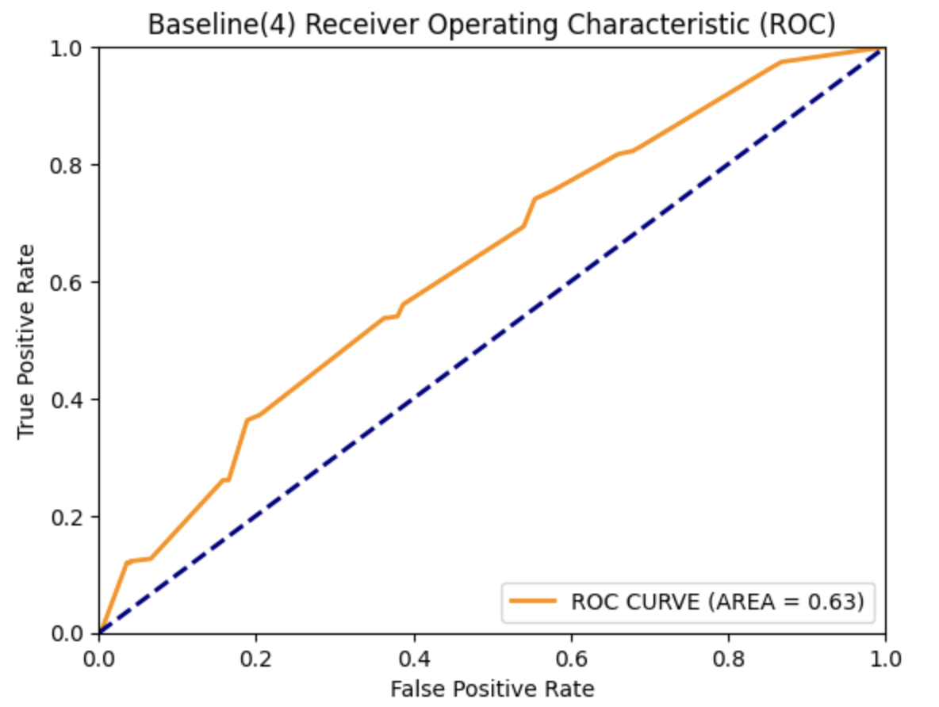
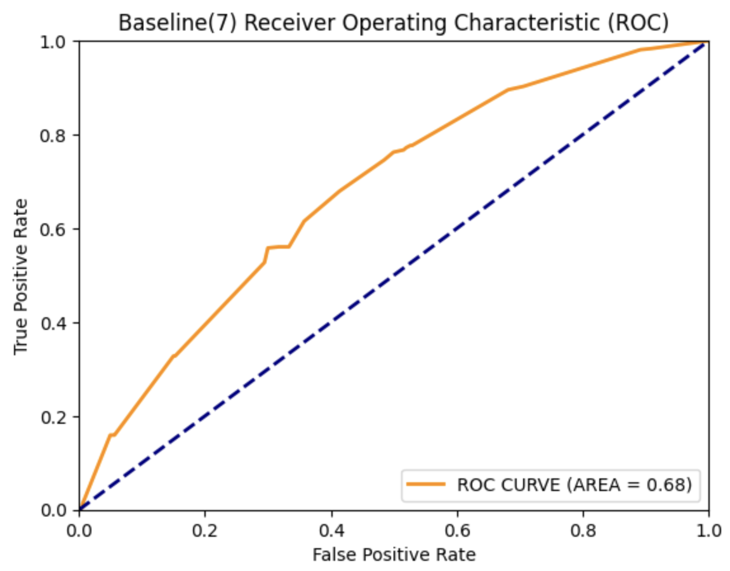
Regression models based on race and KLG

Slide 14
What did we learn?
Ordinal classification of predicting 0 - 10 class performs poorly
Minimal performance difference when training on patients excluded by ICD codes vs. training on all patients and NOT excluding by ICD codes
Prevalence of non-painful knees is low compared to other knee datasets. Radiographs are not performed on patients that don’t have symptoms

Slide 15
Next Steps
Expert evaluation to recognize anatomical features to understand differentials
CPT code for procedures to see if there was anything done next
Subgroup evaluation by age, sex, race [Cross Evaluation]
Check Pain Reporting Inventory for biases
Using original bilateral knee radiographs
Intelligent ICD code imputation (using a trained CNN model)

Slide 16
Summary Slide
MRKR dataset population is unique to other knee datasets and results may
Threshold for pain score impacts performance
We would prefer a different metric to determine the pain related to a patient’s knee osteoarthritis instead of numeric pain score 0 - 10.

Slide 17

Pre

Slide 18

Post

Slide 19
The Emory Knee Radiography Dataset
(MRKR)
August 2023

Slide 20
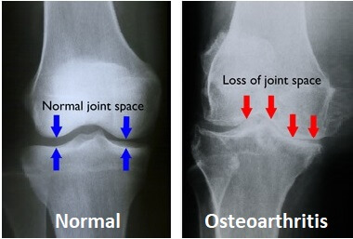

Slide 21
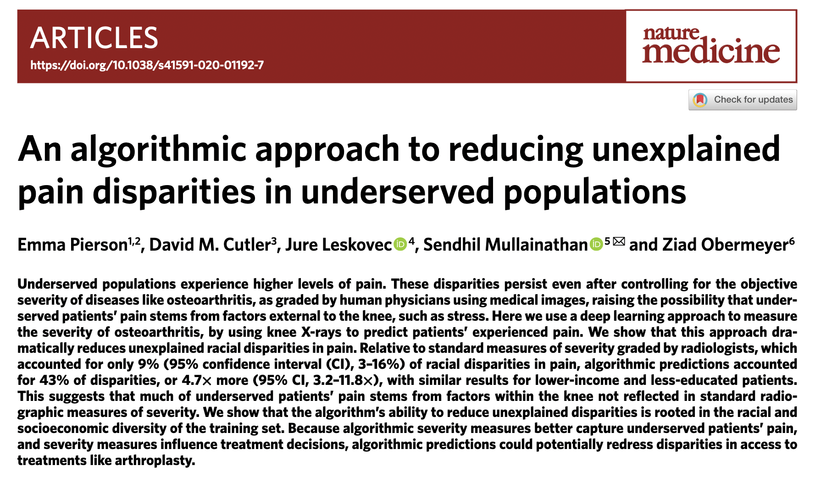

Slide 22
The Emory Knee Radiography Dataset
(MRKR)
August 2023

Slide 23
The eMoRy Knee Radiography Dataset
(MRKR)
August 2023

Slide 24
What type of data is included?
Knee radiographs
ICD codes
Patient reported pain symptoms
Severity of osteoarthritis
Patient demographics
Notes:
518,938 radiographs

Slide 25
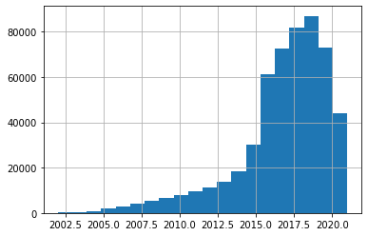
Knee Radiographs
Date range: 2002 — 2021
Total patients: 89,621
Total studies: 178,641
Total images: 518,938

Slide 26
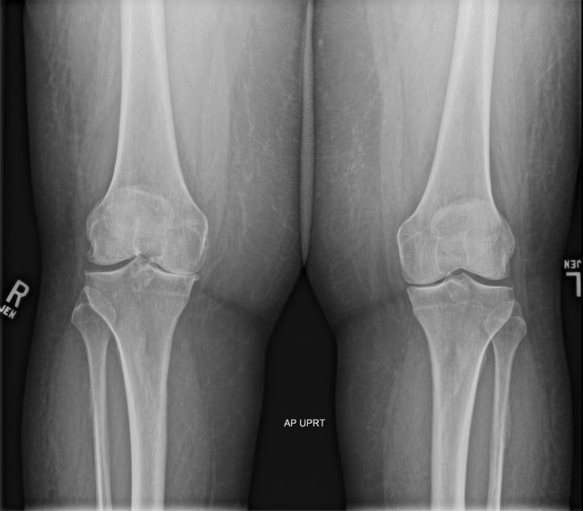
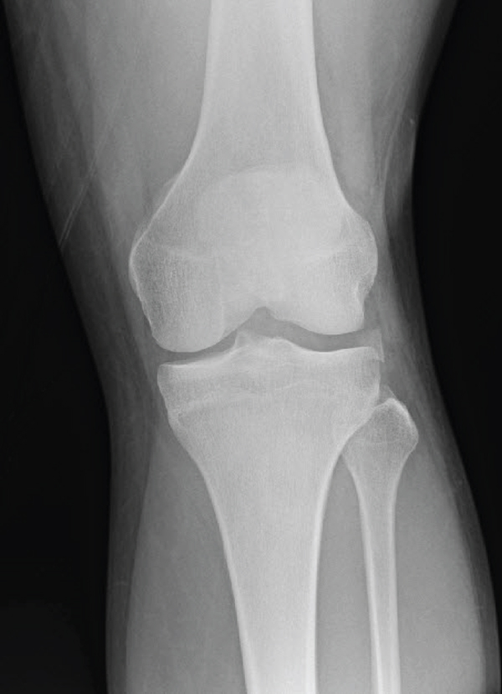
Knee Radiographs View Positions
Both knees (bilateral), left AND right
One knee (unilateral), left OR right

Slide 27
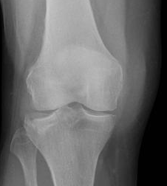
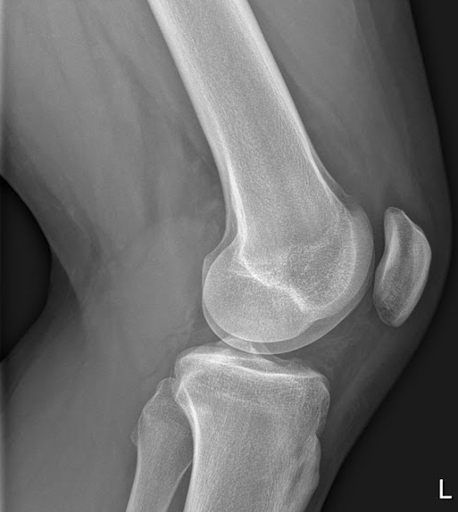
Knee Radiographs View Positions
Frontal
Lateral

Slide 28
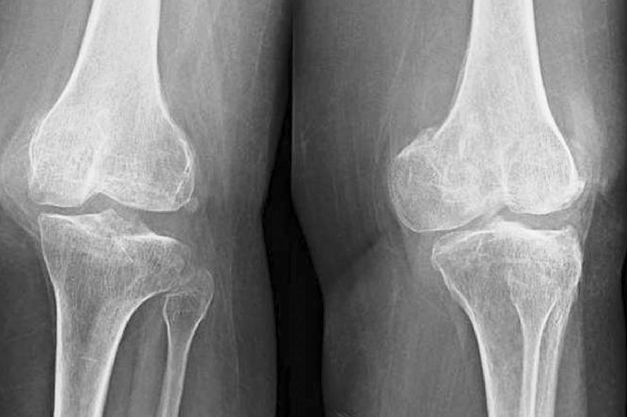
Knee Radiographs View Positions
Oblique

Slide 29
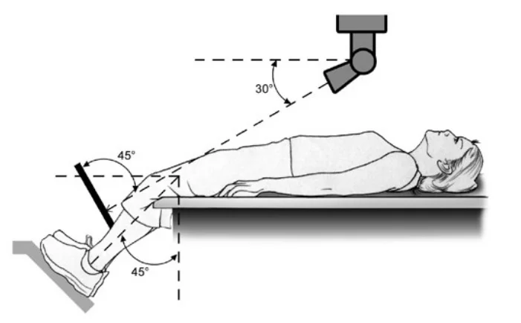
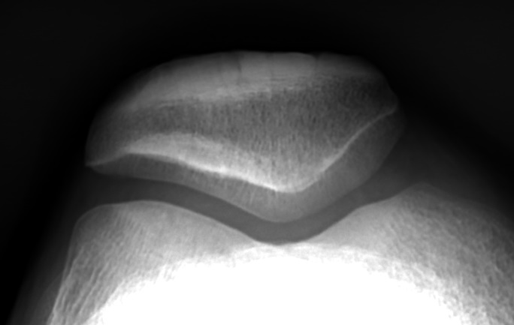
Knee Radiographs View Positions
Sunrise/Merchant View

Slide 30
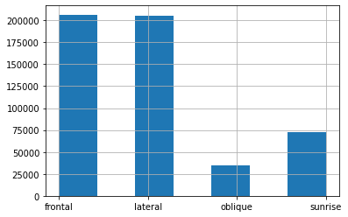
Knee Radiographs View Positions
Frontal 206,520 (40%)
Lateral 205,649 (40%)
Oblique 34,268 (7%)
Sunrise 72,501 (14%)

Slide 31
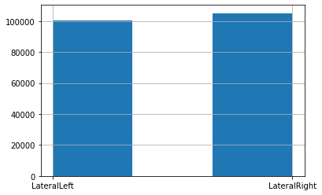
Knee Radiographs View Positions
Lateral Left: 100,536 (49%)
Lateral Right: 105,113 (51%)

Slide 32
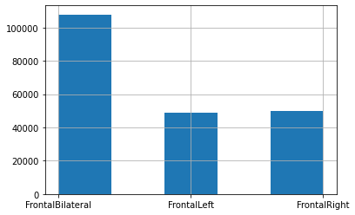
Knee Radiographs View Positions
Frontal Bilateral:107,872 (52%)
Frontal Left: 48,951 (24%)
Frontal Right: 49,697 (24%)

Slide 33
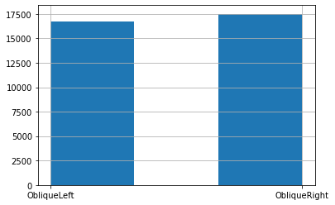
Knee Radiographs View Positions
Oblique Left: 16,761 (49%)
Oblique Right: 17,507 (51%)

Slide 34
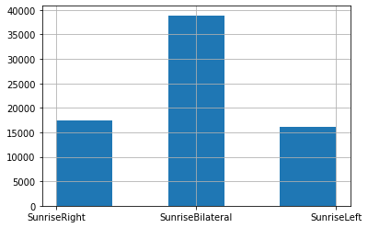
Knee Radiographs View Positions
Sunrise Left: 16,191 (22%) Sunrise Bilateral:38,893 (54%)
Sunrise Right: 17,417 (24%)

Slide 35
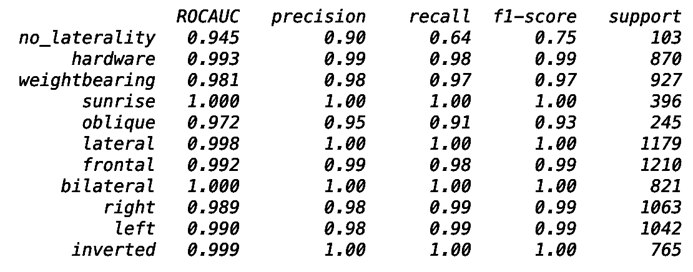
How do we know the View Position labels are accurate?

Slide 36
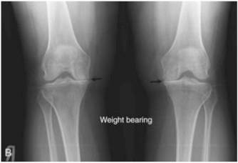
Knee Radiographs, Weight-bearing
Patient stands on a horizontal surface
Radiographs without weight-bearing may underestimate the degree of osteoarthritis
Weight-bearing radiographs are indicated with
“WB”, “STANDING” printed on the image
Laterality Beads

Slide 37
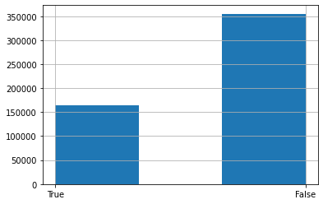
Knee Radiographs, Weight-bearing
True: 163,885 (32%)
False: 355,053 (68%)

Slide 38
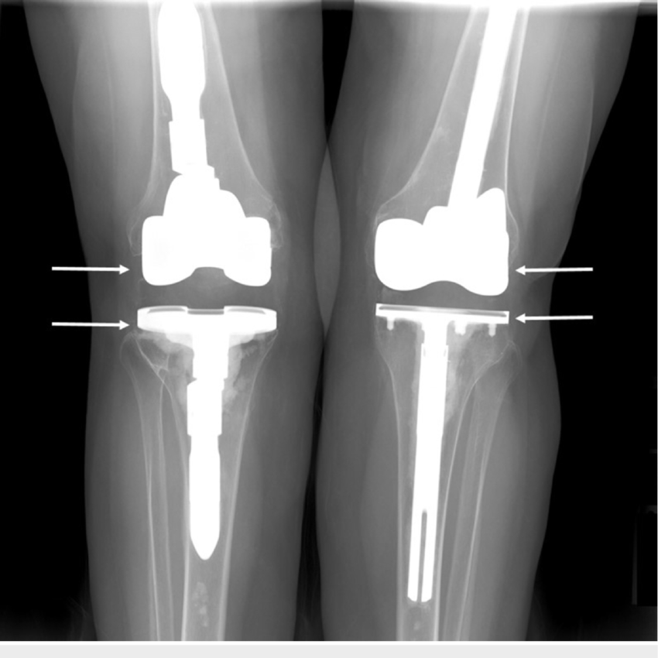
Knee Radiographs, Hardware
Material placed surgically in the patient is labeled hardware, like in a total knee arthroplasty.
Judging the degree of osteoarthritis severity cannot be done if the knee joint has been replaced surgically

Slide 39
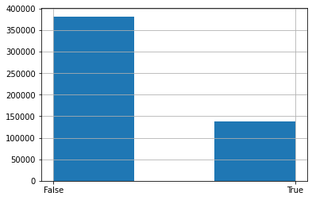
Knee Radiographs, Hardware
False: 381,381 (73%)
True: 137,557 (27%)

Slide 40
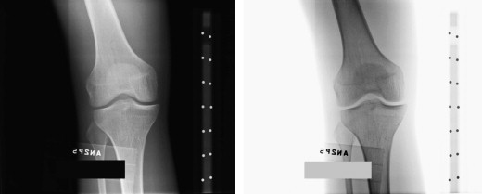
Knee Radiographs, Inversion
CONVERT
INVERTED
IMAGES

Slide 41
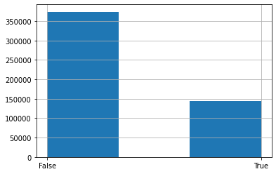
Knee Radiographs, Inversion
False: 374,131 (72%) True: 144,807 (28%)

Slide 42
Classification Performance

Slide 43
A little something about bilateral exams…
It can be difficult to manage bilateral knee exams. By convention, most bilateral exams are performed with the right knee on to the left of the screen. For example, imagine the patient is look at you and their right side is to your left like in AP chest x-rays. However, some bilateral knee exams have the left knee to the left of the screen.

Slide 44
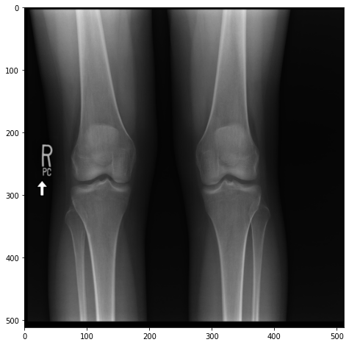
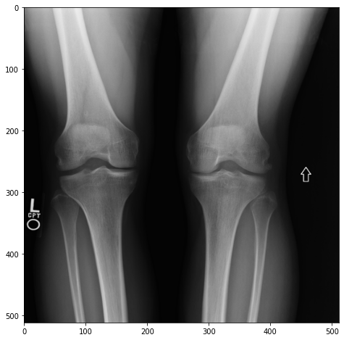
A little something about bilateral exams…
Bilateral knee exams with right knee to left of the screen: 96,772 (90%) Bilateral knee exams with left knee to the left of the screen: 11,100 (10%)

Slide 45
datathon_MRKR_imaging_distilled.csv
Field Name | Data Type | Description
empi_anon | integer | Unique patient identifier
SeriesInstanceUID_anon | string | Unique series identifier
StudyInstanceUID_anon | string | Unique study identifier
image | string | Unique single image identifier, useful merging/linking
png_path | string | File path to knee radiograph image
ViewPosition_corrected | string | Technique and method used to capture the knee radiograph
StudyDate_anon | YYYY-MM-DD | Date when radiograph was captured
hardware | binary | True if metal is present inside lower extremity
weightbearing | binary | True if radiograph was captured while patient had full weight on knees
inverted | binary | True if radiograph has grey-scale inversion
horizontal_flip | binary | True if original radiograph originally oriented with the patients left side on the left of the image

Slide 46
ICD codes
ICD codes come from two different EHR sources
Orthopedic surgical clinic
Emory health care system

Slide 47
datathon_MRKR_icd.csv
Field Name | Data Type | Description
empi_anon | integer | Unique patient identifier
diagnosis_date_anon | YYYY-MM-DD | Date of entered diagnosis
DX_CODE_ICD10 | string | Filtered ICD 10 code relating to the knee (11456 unique ICD codes)
DX_NAME | string | Description of ICD 10 codes
knee_osteoarthritis | binary | True if ICD 10 code includes prefix M17 indicating knee osteoarthritis
general_osteoarthritis | binary | True if ICD 10 code includes prefixes M15 — M19 indicating osteoarthritis of any joint
trauma_lower_extremity | binary | True if ICD 10 code included prefixed M70 - M99 indicating trauma to the thigh, knee or ankle.
diabetes | binary | True if ICD 10 code indicates diagnosis of diabetes any type
hypertension | binary | True if ICD 10 code indicates diagnosis of hypertension any type
joint_infection | binary | True if ICD 10 code indicates diagnosis of knee joint infection
osteomyelitis | binary | True if ICD 10 code indicates osteomyelitis in the lower extremity
autoimmune | binary | True if ICD 10 code indicates any rheumatoid or autoimmune arthropy of the knee, including gout

Slide 48
datathon_MRKR_pain.csv
Field Name | Data Type | Description
empi_anon | integer | Unique patient identifier
pain_location | string | Original text entered by healthcare worker indicating the source/location of pain
new_pain_location (I need to rename this in the future) | string | Refined pain location based on keywords, filtered to include only locations related to the knee, lower extremity, and general. Also including undetermined locations described as “unknown”.
laterality | string | Right knee, left knee, both knees or undetermined. If this field is a ‘0’ this is because the patient has no pain.
pain_timestamp_anon | YYYY-MM-DD | DateTime for when pain score is recorded

Slide 49
datathon_MRKR_KLG.csv
Field Name | Data Type | Description
empi_anon | integer | Unique patient identifier
series | string | Unique series identifier can use ‘SeriesInstanceUID_anon’ to link
study | string | Unique study identifier can use ‘StudyInstanceUID_anon’ to link
image | string | Unique single image identifier, useful merging/linking
laterality | string | ‘L’ or ‘R’ — Will be helpful in linking pain scores
png_path | string | File path to radiographic image
cropped_png_path | string | File path to cropped images only including the knee joint
later / median JSN | integer | Degree of joint space narrowing
KLG | integer | Severity of osteoarthritis

Slide 50
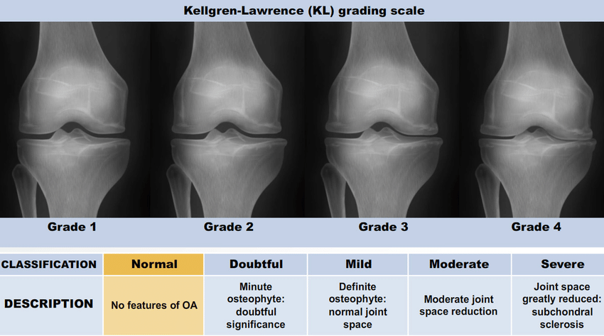

Slide 51
datathon_MRKR_demographics.csv
Field Name | Data Type | Description
empi_anon | integer | Unique patient identifier
DOB_anon | string | Original text entered by healthcare worker indicating the source/location of pain
GENDER | Male OR Female | Unfortunately there are no additional values included in this field to represent non-binary patients
RACE | string | Patients self-reported race
ETHNICITY | string | Hispanic or non-hispanic

Slide 52
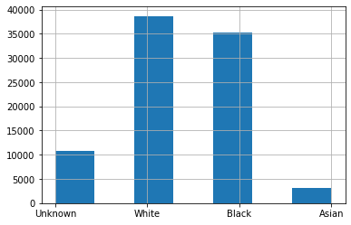
Demographics, Race
Black 38,681 (41%)
White 35,197 (43%)
Unknown 10,710 (11%)
Asian 3,059 (3%)
Multiple 594 (1%)
Native American 261 (<1%)
Native Hawaiian (<1%)

Slide 53
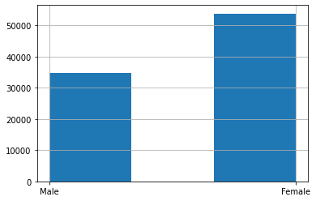
Demographics, Gender
Female: 53,833 (61%)
Male: 34,838 (39%)

Slide 54
What pain score to use?
If numeric pain score 0 — 10 is utilized
Using NIH OAI dataset, numeric pain score with KOOS, correlation R² = 0.768
Using KOOS threshold of 86.1 to indicate a painful knee and a numeric pain score of 4 or more…
Accuracy: 0.881
Sensitivity: 0.708
Specificity: 0.953

Slide 55
Is there a disparity in reported pain?
RACE

Slide 56
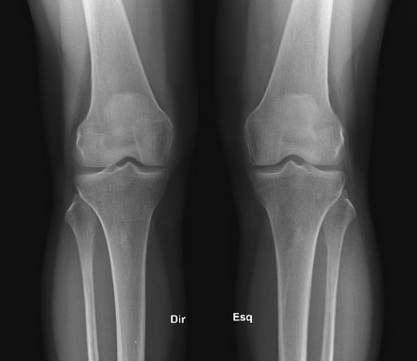
Cropped images (136,102 knees) 672 x 672

Slide 57
Cropped images (136,102 knees) 672x672

Slide 58
NIH Data

Slide 59
merged_tables_NIH_OAI_2023.csv
Field Name | Data Type | Description
patient_ID | integer | Unique patient ID
interval | integer | Indicates months since initial screening
laterality | string | ‘L’ or ‘R’
BMI | integer | Body Mass Index
age | integer | Indicates patients age
race | string | ‘Asian’, ‘Black’, ‘White’, ‘Other/Unknown’
png_path | string | Path for image
koos_pain_total | float | KOOS pain score
numeric_pain | integer | 0 to 10 pain score
rheumatoid_arthritis | binary | Indicates prior RA diagnosis
total_knee_replacement | binary | Indicates TKA

Slide 60
Questions?

Slide 61
https://github.com/Emory-HITI/datathon/tree/main/teams/team_1
https://jhub9.datathon.org/
https://github.com/Emory-HITI/datathon.git
GOOGLE DOC https://docs.google.com/document/d/18hP2z8ddEvAlpKSVd3zeCKHNEANl5VjLqHqLFiKdI5s/edit?usp=sharing

Slide 62
fit a linear regression with
KOOS pain score as the dependent variable
two independent variables: binary race or socioeconomic group and a measure of osteoarthritis severity (see below for specifics)
ALG-P vs KLG
first rescaled KLG by predicting pain from KLG (in the combined training and development sets) using a regression in which KLG was coded as a categorical variable, with a separate coefficient for each of the five levels; this allowed for maximum flexibility in predicting pain from KLG, in case the relationship between the two was nonlinear. Lasso regression was used as a standard technique to prevent overfitting
Conceptually, the output of this regression model (which was generated in the held-out set) was a rescaled KLG on the same scale as KOOS pain score and thus the same scale as ALG-P)
The pain disparity was defined as the coefficient on binary race or socioeconomic group; that is, the gap in mean pain between racial or socioeconomic groups when controlling for severity.

Slide 63
Rationale for Exclusion Criteria here:
[To be added]

Slide 65
Filtering criteria
We filtered OUT
400k we lost based on the view
ICD10 codes
Trauma, infection, rheumatoid arthritis, gout
Missing (20k/50k were excluded of those that we know)
Age <45 & >79
Assumptions / Missing values
Where we do not have a pain rating we assumed it was 0
Next Steps:
Do the analysis without

